Slide 1
Operating Systems
UBMS Stem Experience: Jurassic Park

Slide 2
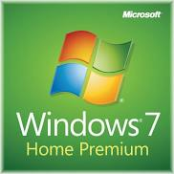
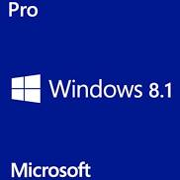
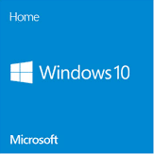
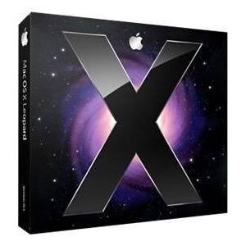
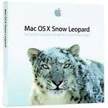
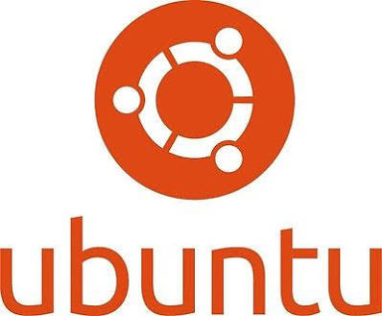

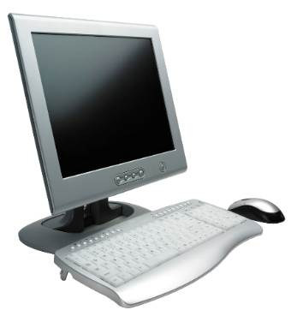
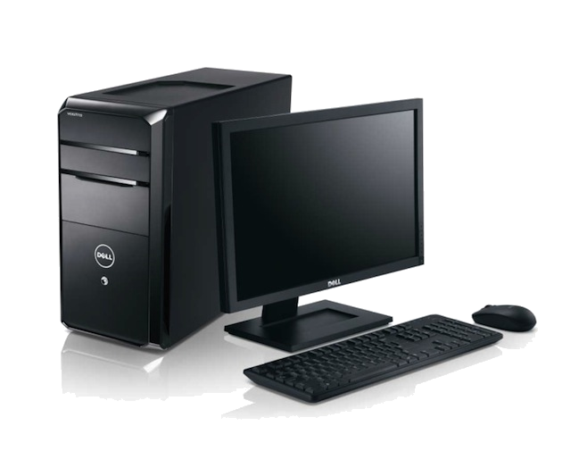
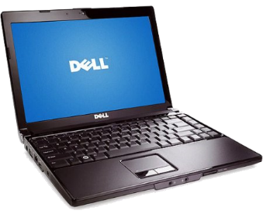
Types of Operating Systems
Desktop Operating System
Typically installed on a personal computer (PC) that is used by one person at a time, and that may or may not be connected to a network.
The hardware for a desktop computer can be in several forms, such as:
Notes:
TYPES OF OPERATING SOFTWARE
Desktop Operating System
typically is one installed on a personal computer (PC) that is used by one person at a time, and that may or may not be connected to a network.
The hardware for a desktop computer can be in several forms, such as:
A full desktop computer consisting of separate components for the monitor, CPU box, keyboard, and mouse
A portable or laptop unit that combines the monitor, CPU box, keyboard, and pointing device in an all-in-one device that is easy to carry
A combination in which the monitor and CPU are in one unit with a separate keyboard and mouse.

Slide 3
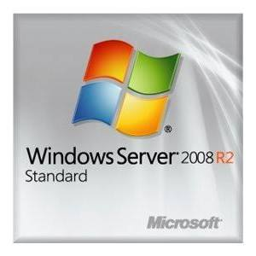
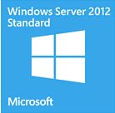
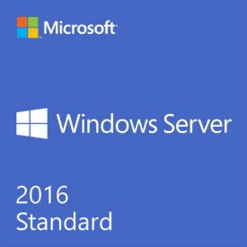

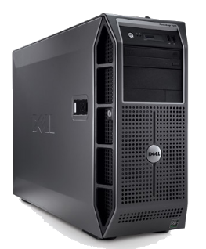
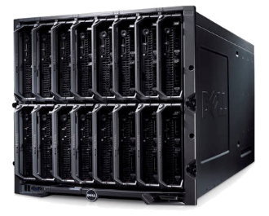
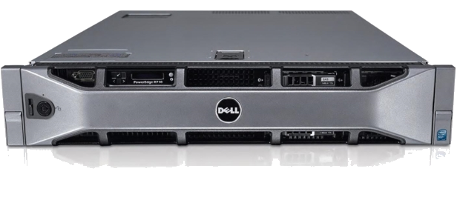
Types of Operating Systems
Server Operating System
Usually installed on a more powerful computer that is connected to a network and can act in many roles.
The server hardware can also take different forms such as
Notes:
TYPES OF OPERATING SOFTWARE
Server Operating System
Usually installed on a more powerful computer that is connected to a network, and can act in many roles to enable multiple users to access information, such as electronic mail, files, and software.
The server hardware can also take different forms such as
traditional server hardware,
rack-mounted server hardware,
and blade servers.

Slide 4
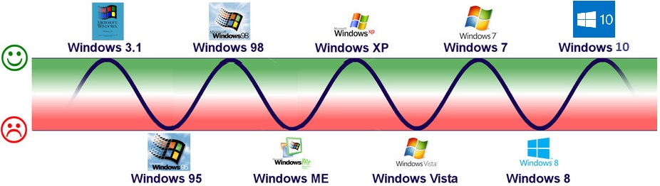
The Microsoft Curse

Slide 5
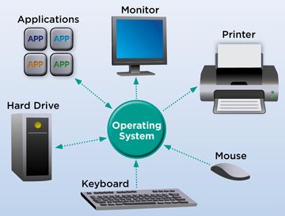
Functionality
Deals with input/output (I/O) functions.
Translate instructions into low-level requests that the hardware can understand and carry out.
An interface between application software and hardware.
Notes:
FUNCTIONALITY
One of the most basic tasks of an operating system is to take care of what are known as input/output (I/O) functions.
The I/O functions take requests from the software the user runs (the application software), and translate them into low-level requests that the hardware can understand and carry out.
An interface between application software and hardware.
Operating systems perform the following I/O tasks:
Handle input from the keyboard, mouse, and other input devices
Handle output to the monitor and printer
Handle remote communications using a digital modem (such as a cable modem) or analog modem (for non-digital telephone communications)
Manage network communications, such as for a local network and the Internet
Control input/output for devices such as a network interface card
Control information storage and retrieval using various types of disk, DVD/CD-ROM, and removable storage drives
Enable multimedia use for voice and video composition or reproduction, such as recording video from a camera or playing music through speakers

Slide 6



How Operating Systems work?
SOFTWARE
APPLICATIONS
KERNEL
OPERATING
SYSTEM
BIOS/UEFI
SYSTEM UTILITIES
DEVICE DRIVERS
Notes:
There are many elements that go into enabling an operating system to work with the computer on which it is loaded.
These include but are not limited to:
The kernel
Device drivers
Application software
BIOS/UEFI
All the above work together to bring to you a great computing experience.

Slide 7
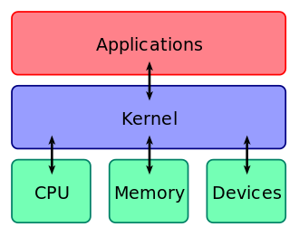
1. Kernel
Kernel is intermediary between applications and hardware
Manages prioritization of applications
Manages RAM and CPU usage
Prevents two devices or programs conflicting for use of RAM or CPU at the same time
Conflicts will cause an error or system panic, also referred to as a crash
Device input/output has to be managed as well to prevent conflicts
Notes:
KERNEL
The kernel consists of the essential program code of the operating system.
Compare this to a vehicle:
The engine in a vehicle is essentially at the heart of the vehicle enabling it to transport the driver and passengers.
However, the car’s driver uses human interfaces, such as the steering wheel, throttle pedal, and dashboard controls to communicate with the engine.
In the same way, the kernel might be thought of as the software engine that drives a computer and the desktop or shell is the human interface that enables the user to interact with the kernel.
Kernel Jobs…
The jobs performed by the kernel can include:
Managing interactions with the CPU
Starting, managing, and scheduling programs that handle I/O activities, including device and networking activities
Handling basic computer security
Managing use of the computer’s memory (RAM)
Managing priority levels assigned to programs and computer processes

Slide 8
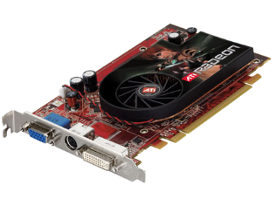
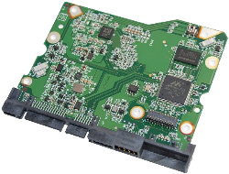
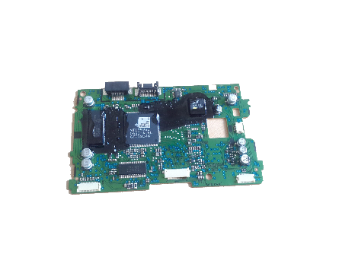
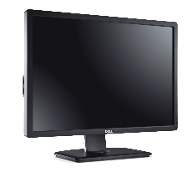
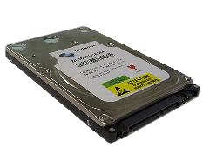
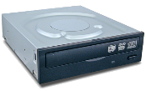
2. Device Drivers
Software code that allows the kernel to interact with the hardware and vice-versa
All hardware has drivers specific to it
Drivers are also specific to the OS
OPERATING SYSTEM
Operating System KERNEL
Software
Monitor Driver Code
Disk Driver Code
Monitor Device Driver
HDD Device Driver
DVD/CD Device Driver
Video Card
Hard Disk Controller
DVD/CD-ROM Controller
Hardware
Monitor
Hard Disk drive
DVD/CD-ROM Drive
Notes:
3. THE OS AND DEVICE DRIVERS
The operating system communicates and works directly with many devices, such as the monitor, keyboard, disk drives, mouse, network adaptor, speakers, and so on.
Some operating system programs exchange information with specific hardware (chips) inside the computer that control these devices.
The code (instructions) for this information exchange is typically referred to as a device driver.
A device driver translates computer code to display text on a screen, or translates movements of a mouse into action, for example.

Slide 9
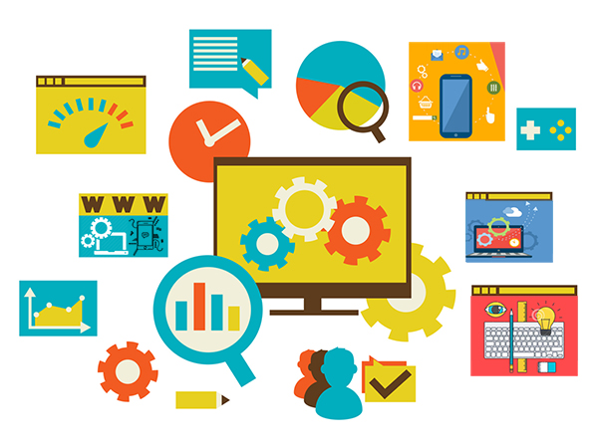
3. Application Software
Created to be user-facing
Application Program Interfaces (API) allow applications to interact with the Operating System
Applications are not given direct access to the hardware, that must go through the operating system
Notes:
4. APPLICATION SOFTWARE
In addition to communicating with computer hardware, the operating system communicates with the application software running on the computer.
Application software is a fairly vague term; it can mean a word processor, spreadsheet, database, computer game, or many types of other applications. Basically, it means any program a user might choose to run on the computer.
If an application program accesses a piece of hardware, it sends a request to the operating system to execute the job.
For example, the application program may have to access the keyboard to see if a user has pressed a key, or the monitor to show the user a message. This makes the application programmer’s job easier because the user does not have to know exactly how to manipulate the chips in the computer to communicate with the keyboard, monitor, or printer. The user only has to know how to communicate with the operating system.

Slide 10
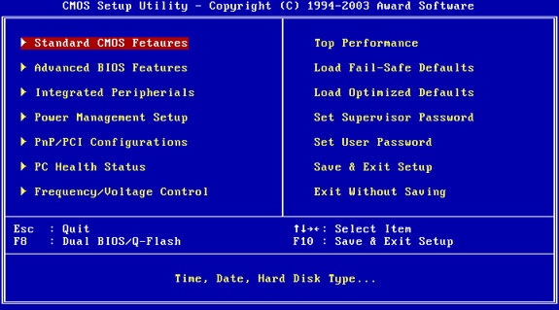
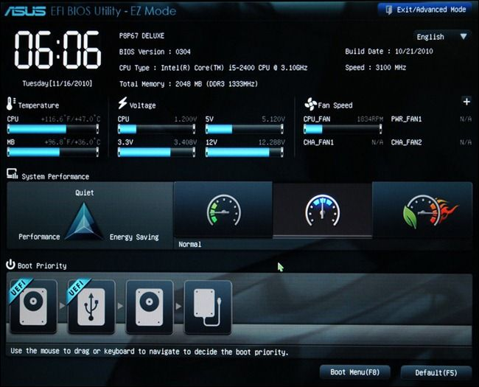
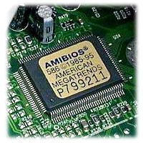
4. BIOS/UEFI
Responsible for POST
Responsible for initiating the OS boot process
Handles low-level software & hardware functions
Notes:
5. BIOS
An essential step in starting a computer is to load the basic input/output system, or BIOS.
The BIOS is low-level program code that:
Initiates and enables communications with hardware devices
Performs tests at startup, such as memory and hardware component tests, which are in total called the power-on self test (POST)
Conducts basic hardware and software communications inside the computer
Starts a full-fledged operating system that interfaces with the user
Some consider the BIOS a rudimentary operating system and others consider it to simply be a set of important program code routines between the hardware and the main operating system.

Slide 11
OS Components

Slide 12

User Interfaces (UI)
Required to give the user a way of interacting with the computer
OS is responsible for building the interface and handling input from the user
OS interprets user input and takes appropriate actions
Different OS’s have their own flavors of user interfaces
Two main types of UI:
Composite user interfaces (CUI)
Command Line Interface (CLI)

Slide 13
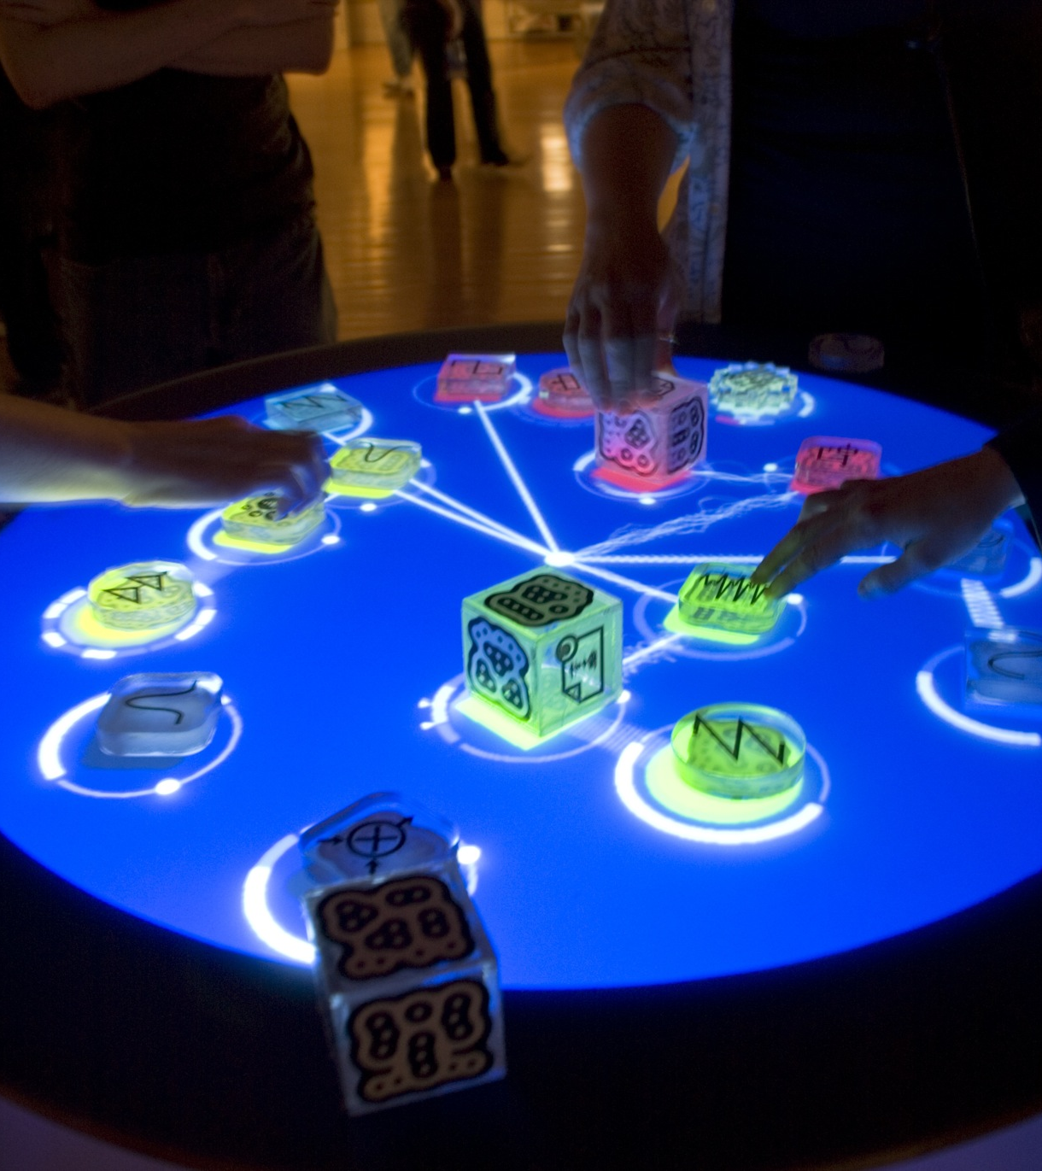
Composite User Interfaces (CUI)
A user interface that interacts with two or more senses
Graphical User Interface (GUI)
Virtual User Interfaces (VUI)
Augmented Reality (AR)

Slide 14
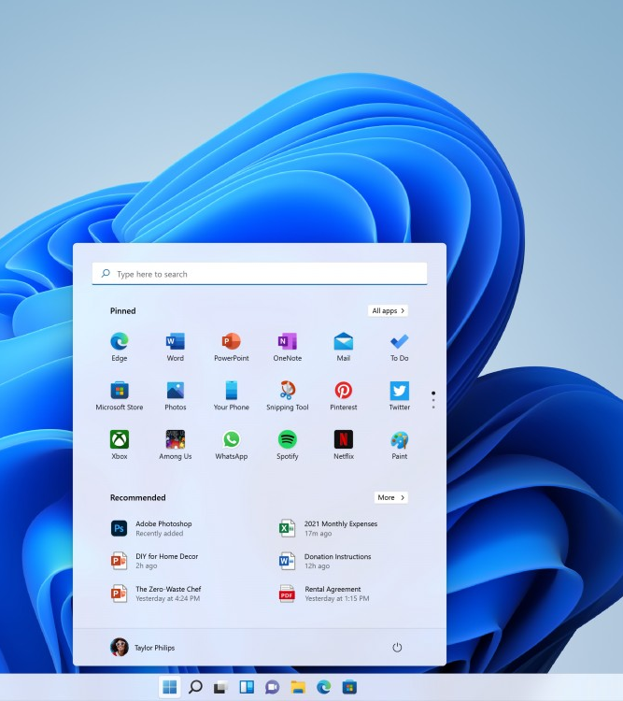
CUI Type: Graphical User Interface (GUI)
Most common type of CUI (at least today)
Combines visual and tactile UI

Slide 15
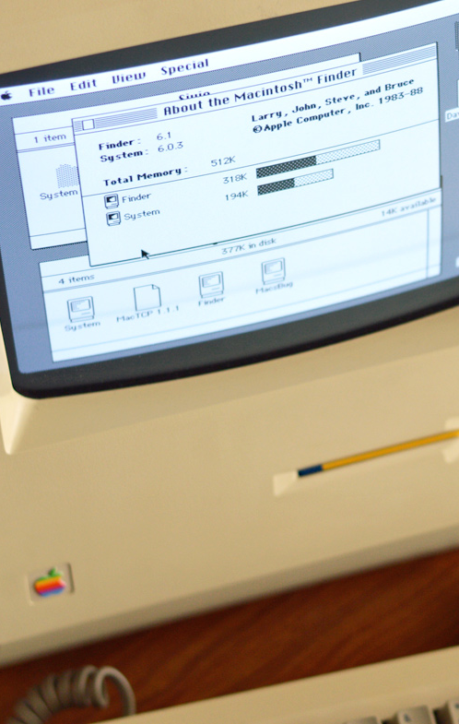
CUI Type: Graphical User Interface (GUI)
Allows users to interact with a computer using symbols, visual metaphors and pointing devices
aka ‘you have buttons and icons’
‘First’ GUI was designed by Xerox in the 1970’s
Made popular by Apple’s Macintosh and then Microsoft’s Windows OS
Most common way of interacting with computers today
Notes:
Ref: https://www.britannica.com/technology/graphical-user-interface

Slide 16
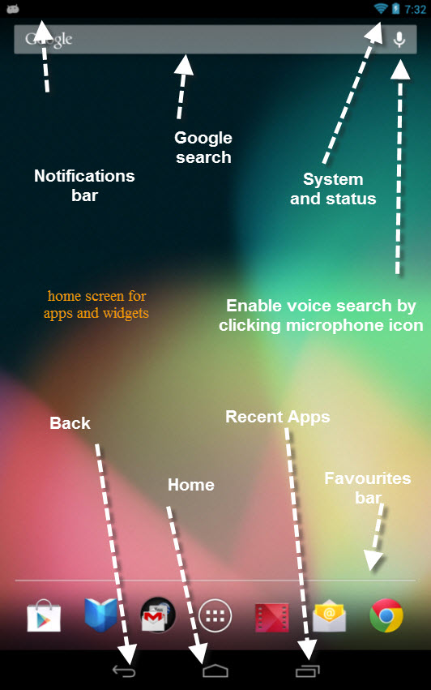
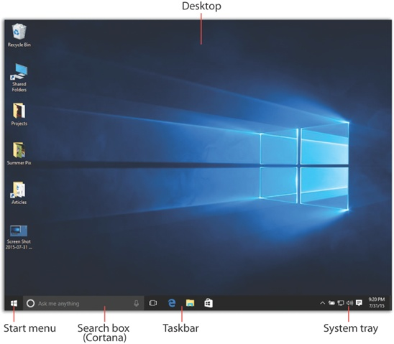
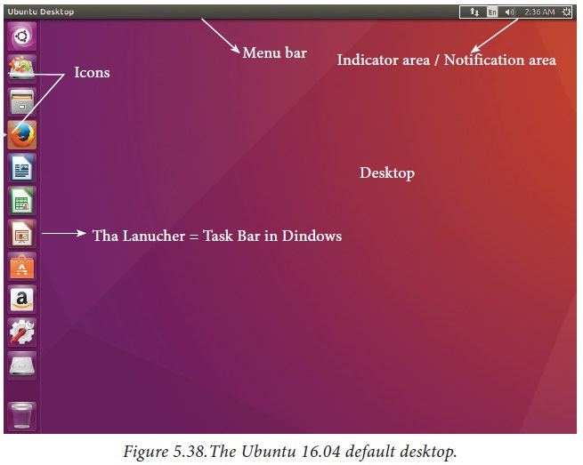
CUI Type: GUI Common Elements
Home Access
Desktop Area
Shortcuts
Notifications Area
Window Manager
Application Access
System Controls
User Input
Notes:
Ref: https://www.britannica.com/technology/graphical-user-interface

Slide 17
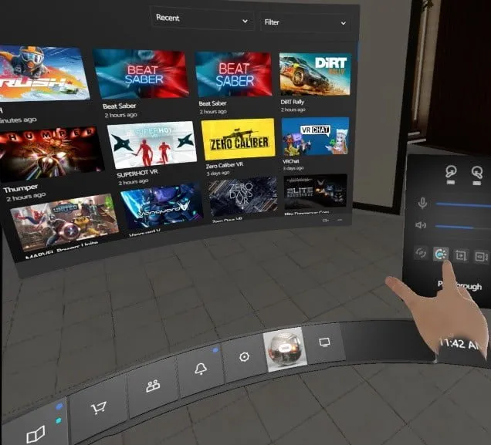
CUI Type: Virtual User Interfaces (VUI)
Uses a virtual reality headset
Popular models are Oculus Quest, HTC Vive, Valve Index
Blocks out a virtual world

Slide 18
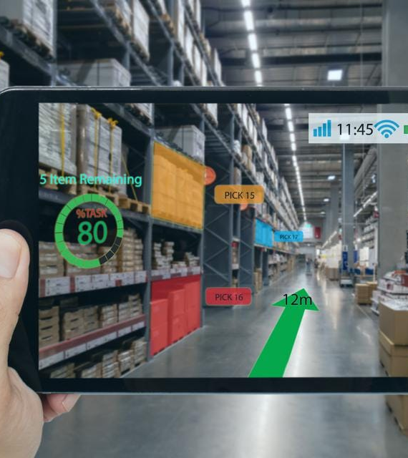
CUI Type: Augmented Reality (AR)
Uses hardware to let you see real world with virtual overlay
Popular applications are Google Glasses, Pokemon Go, Toys to Life
Does not block out the world, overlays onto the real world

Slide 19
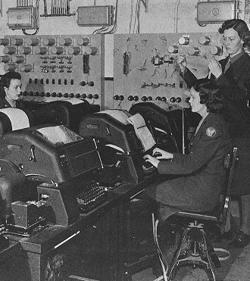
Command Line Interface (CLI)
Text-based interface that allows users to interact with a computer by supplying specific commands and arguments.
The OG way of interacting with computers
Evolved from teleprinters developed in the late 1830’s
A text input/output environment
Incorrectly called a terminal

Slide 20
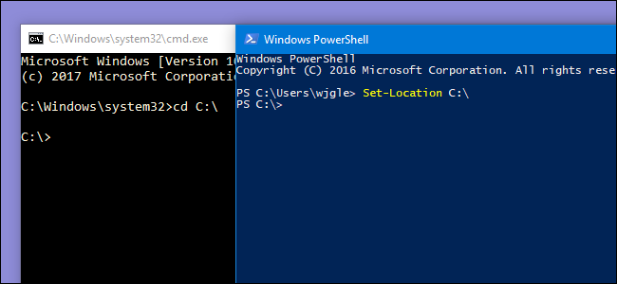
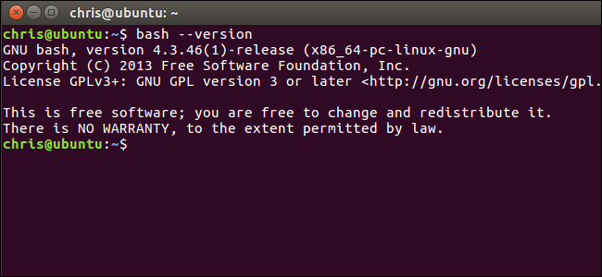
CLI: Common Elements
Prompt
Commands
Parameters
The void
Despair

Slide 21
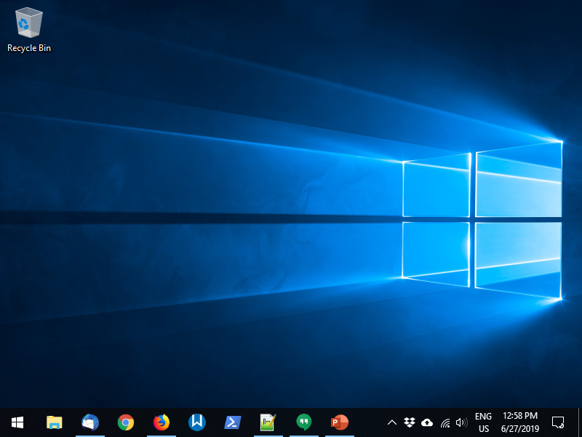
Windows OS: Desktop
Hidden System Tray Apps
Recycle bin for deleted files
Desktop for icons, links, etc.
System Tray Apps
Task bar – currently open apps + quick access links to apps
Notifications and system controls
Start Menu – list of installed programs, shortcuts, search menu, settings

Slide 22
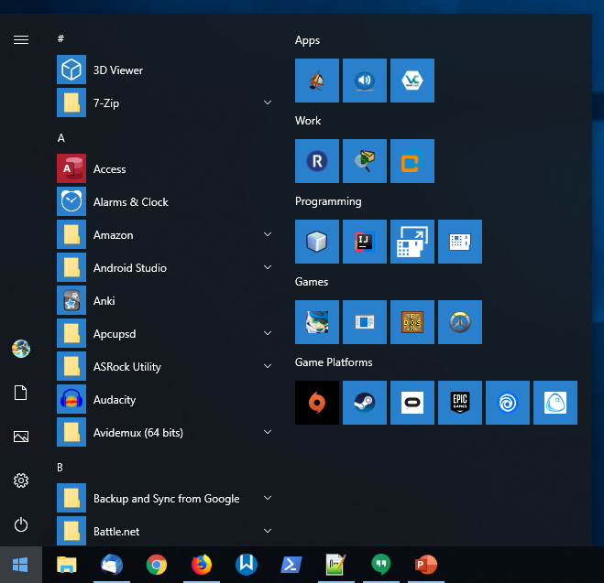
Windows 10: Start Menu
Customized Headers
Tiles (Pinned Apps)
Installed Apps
List
User account controls
Windows Settings
Shutdown Controls

Slide 23
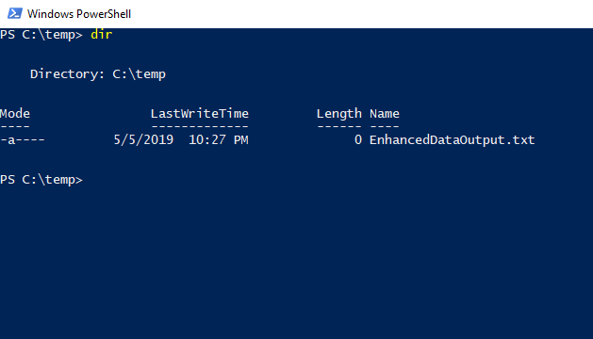
Windows 10: CLI - PowerShell
Command
Terminal Prompt
Command Output

